Slide 1


English Olympiad
Inspiring Leadership

Slide 2

CONTENTS
1. Our Mission
2. Problem in the Market
3. Our Solution
4. Our Complete Ecosystem
5. Our Journey & Milestones
6. Proven Traction & Global Reach
7. How It Works
8. Market Size
9. Our Impact
10. Join Us
11. Thank You

Slide 3

1. Our Mission
To empower students from non-native English-speaking countries by providing a global platform to compete, learn, and grow as the leaders of tomorrow. We are dedicated to inspiring leadership through excellence in the English language, preparing young minds to face global challenges with conviction and care.

Slide 4


2. Problem in the Market
A fragmented market fails to connect academic learning with real-world validation.
Gap in Credibility
Lack of a Global Stage
Theory vs. Application
Parents and students seek prestigious, globally recognized extracurriculars, but few accessible options exist beyond expensive, high-stakes exams.
Talented students have no central platform to benchmark their English skills against international peers in a competitive, motivating environment.
Standard education focuses on grammar and vocabulary but often neglects the practical communication and leadership skills required for global success.

Slide 5
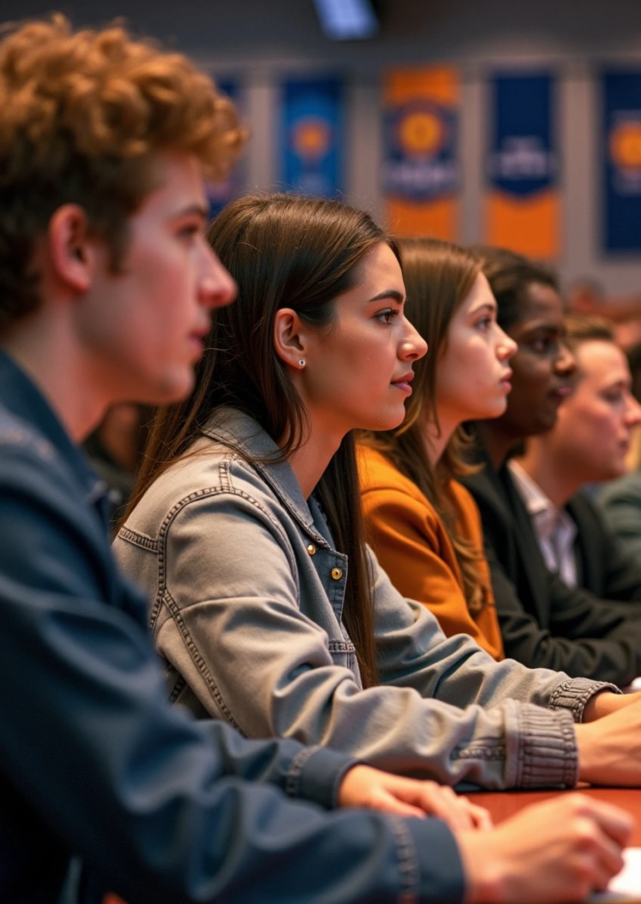



3. Our Solution
A unified global platform for English proficiency and leadership development. English Olympiad provides a three-pronged solution:
1
Competition
We offer an accessible, prestigious, and globally recognized stage for students to prove their skills, win awards, and build their academic profiles.
2
Community
We connect over 175,000 students and 5,000+ ambassadors, creating a powerful network for learning and growth.
3
Development
We go beyond competition with workshops and resources that build the critical leadership and communication skills necessary for future success.

Slide 6


4. Our Complete Ecosystem
A full suite of tools and events to master the English language. English Olympiad offers a complete ecosystem for English learners:
Books & Publications
Online Courses
Global Competitions
Skill-Building Workshops
Access our "English Mania" books and find publications at jabpublication.com.
Take courses designed for all levels via educationfun.org.
Compete with peers from around the world at englisholympiad.net.
Join targeted workshops to enhance practical language skills.

Slide 7

5. Our Journey & Milestones
From a vision in 2016 to a global movement.
Founded
2016
Gross Merchandise Volume (GMV)
50 Crore BDT
Students Served
180,000+
Our consistent growth demonstrates a clear and rising demand for our platform.

Slide 8


6. Proven Traction & Global Reach
Our numbers speak for themselves. We've built a massive, engaged community.
180,000+ Students Engaged
100+ Countries Reached
6,500+ Campus Ambassadors
190 Million People Reached Globally

Slide 9



7. How It Works
An inclusive competition for every age and skill level. We offer distinct categories to ensure every participant has a chance to shine:
1
2
Kids
Small Starts
6-8 years old
Grades 3-5
3
4
Juniors
High Flyers
Grades 6-8
Grades 9-10 (O-Level)
5
6
Trailblazers
Seniors
Grades 11-12 (A-Level)
Undergraduate and postgraduate students
Participants advance through selection rounds to compete in a prestigious Grand Finale.

Slide 10


8. Market Size
Tapping into a multi-billion dollar global education market. The demand for verifiable English proficiency and supplementary education is immense and growing.
Total Addressable Market (TAM)
Serviceable Addressable Market (SAM)
Serviceable Obtainable Market (SOM)
The Global English Language Learning market, valued at over $50 Billion.
The youth segment (ages 3-18) in non-native English speaking countries, representing millions of students whose parents invest heavily in supplemental education.
Our immediate target is to capture a larger share in South Asia, Southeast Asia, and the MENA region, building on our existing strong footprint.

Slide 11






9. Our Impact
Creating a tangible difference in the world.
1
Global Recognition
Our work has been appreciated by leaders like Nobel Laureate Professor Muhammad Yunus for its role in fostering global youth leadership.
2
Empowering Youth
We help young individuals compete confidently on the global stage, opening doors to future opportunities.

Slide 12

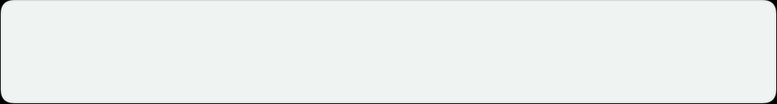
10. Join Us
Join us in inspiring the next generation of global leaders. We are seeking strategic partners and sponsors to help us:
Expand our reach to even more countries.
Enhance our digital platform and resources.
Create more scholarship and award opportunities for deserving students.
Let's empower the future, together.

Slide 13

11. Thank You
Let's Connect.
Website: englisholympiad.net
Email: amansenglish@gmail.com
Phone Number: 01761894704

Slide 14

Thank You

